Slide 1



Slide 2

Build your portfolio project (Week 3): Presentation

Slide 3

Portfolio Project

Slide 4

ALX C22
RODGERS MARAGIA
10 SEP 24

Slide 5

Inspiration
The inspiration for working on this portfolio project stemmed from a desire to showcase my skills and growth as a developer. I aimed to create a comprehensive and interactive platform that reflects my abilities in both front-end and back-end development. By integrating features like user authentication and progress tracking, I sought to demonstrate my capability to handle complex projects and provide a practical example of my technical expertise. This project not only highlights my technical skills but also serves as a testament to my commitment to continuous learning and improvement in the field of software engineering.

Slide 6

Technology &Architecture
Front-End
React.js: Utilized for building the dynamic user interface. React’s component-based architecture allows for reusable UI components, enhancing the maintainability and scalability of the application.
HTML/CSS: Employed for structuring and styling the web pages. CSS frameworks like Bootstrap or Material-UI might be used to ensure a responsive and visually appealing design.
JavaScript: Handles client-side scripting and interacts with the backend through API calls.

Slide 7

Cont' Technology &Architecture
Back-End
Django: Chosen for server-side development due to its robust framework and ease of use in handling data management, authentication, and routing.
Python: The primary language used for backend logic, including business rules and data processing.
PostgreSQL: A relational database used for storing and managing user data and application content.

Slide 8
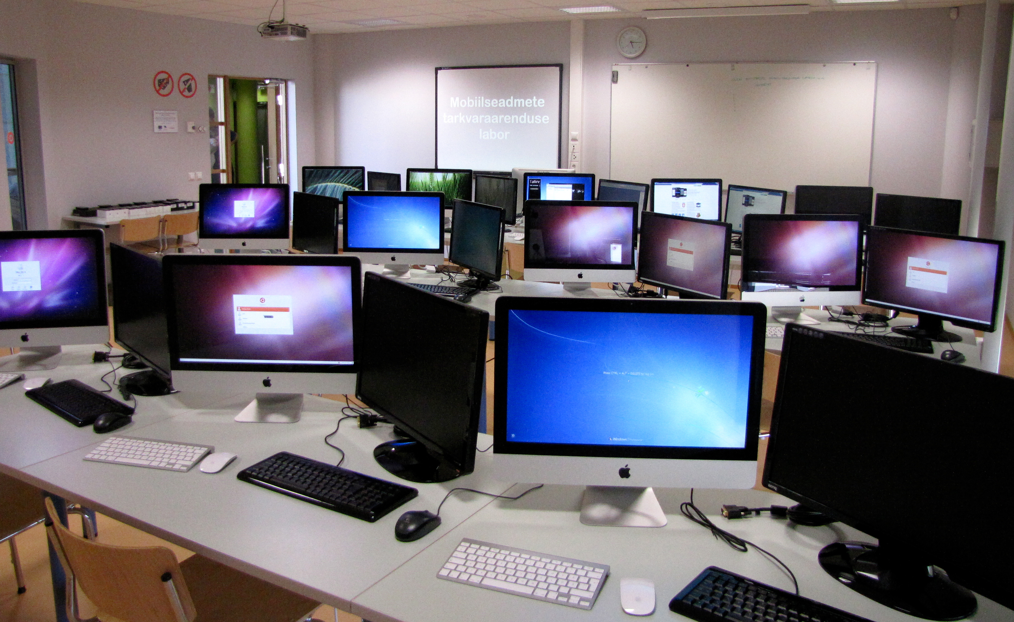
Core algorithms & Code snippet
For my portfolio project, I took complete ownership of both the front-end and back-end development. This involved extensive planning, research, and the integration of key features such as user authentication and progress tracking. I implemented a structured timeline, breaking the project into weekly milestones to ensure steady progress. Despite working independently, I actively sought feedback from peers and mentors to enhance the project and adhere to best practices throughout its development.
Some Code algorithms you can check on my Github Repository.

Slide 9

Challenges
Integration of Front-End and Back-End:
One of the key challenges was ensuring smooth communication between the React front-end and the Django/Flask back-end through REST APIs. Synchronizing data flow, handling errors effectively, and maintaining consistency in requests and responses took careful planning and debugging.
Progress Tracking Logic:
Designing a robust algorithm to accurately track and update user progress for each course proved challenging. Ensuring the system efficiently handles various edge cases, such as partial completion or skipped lessons, required multiple iterations.
User Authentication and Security:
Implementing secure user authentication was crucial. Encrypting passwords, preventing unauthorized access, and managing secure sessions involved integrating JWT tokens and ensuring data protection, which added complexity to the back-end setup.

Slide 10
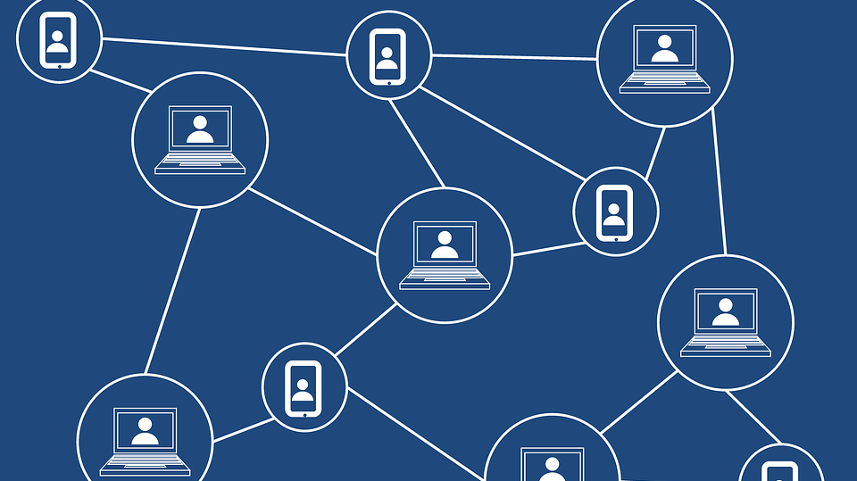
Learnings about technical interests as a result of this project
Through this project, I deepened my understanding of full-stack development by integrating front-end and back-end technologies. I gained hands-on experience with React for building dynamic UIs and Django for robust server-side functionality.
This project also enhanced my skills in implementing user authentication and managing application data. Additionally, I learned the importance of structured development practices, such as adhering to timelines and seeking feedback, to ensure a successful and polished final product.

Slide 11


Q&A

Slide 12

Follow; Github:- @Rockjunior X:- @emarroman

Slide 13
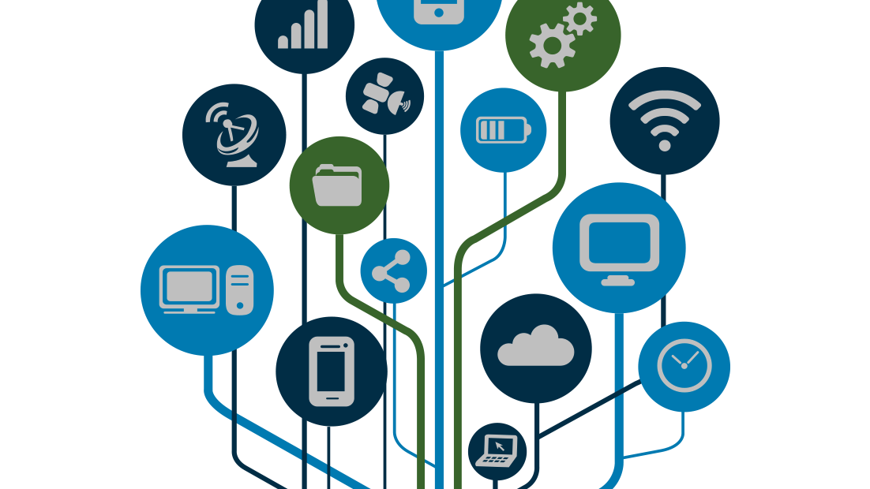
END
Thank You.

